Slide 1
Module 7
Applications of
Embedded Systems

Slide 2
Topics in Module 7
Introduction to embedded system applications using case studies – Role in Agriculture sector, Automotive electronics, Consumer Electronics, Industrial controls, Medical Electronics.

Slide 3
Agriculture Sector

Slide 4
Contents
Introduction
Key Components
Benefits
Sensor applications
Actuator application
Communication
Challenges
Solutions
Future trends
Conclusions

Slide 5
Introduction
Smart Farming using Embedded Systems
Refers to the integration of advanced electronic devices and technologies within agricultural practices to enhance efficiency, productivity.
To revolutionize the traditional farming practices by incorporating advanced tools and systems
Empowers farmers with:
Real time information
Data driven decision making
Reducing resource wastage

Slide 6
Introduction
What is an Embedded System?
A concise definition: "A specialized computer system designed to perform a specific task within a larger system.“
Example: A simple microcontroller-based system controlling a water pump.
Why Agriculture Needs Embedded Systems?
Challenges in traditional agriculture: Labor shortages, climate change, inefficient resource utilization.
How embedded systems can help: Precision agriculture, automated tasks, real-time monitoring.

Slide 7
Key Components
Microcontroller/Microprocessor:
The "brain" of the system.
Sensors:
Devices that collect data from the environment.
Examples: Temperature, humidity, soil moisture, light intensity, pH sensors.
A variety of sensors used in agriculture.
Actuators:
Devices that control physical systems.
Examples: Motors, pumps, valves, LED lights.
Communication Modules:
Enable data transmission and control.
Examples: Wi-Fi, Bluetooth, cellular networks.

Slide 8
Benefits
Increased Productivity:
Optimized resource utilization, reduced labor costs.
Improved Quality:
Precise control of environmental factors.
Reduced Costs:
Efficient use of resources, lower labor costs.
Sustainable Agriculture:
Eco-friendly practices, conservation of resources.

Slide 9
Sensors & Actuators
Sensor Applications in Agriculture
Soil Sensors: Monitor soil moisture, pH, and nutrient levels.
Climate Sensors: Measure temperature, humidity, and rainfall.
Light Sensors: Detect light intensity for optimal plant growth.
Gas Sensors: Detect harmful gases in the environment.
Actuator Applications in Agriculture
Irrigation Systems: Precise water distribution based on sensor data.
Ventilation Systems: Adjust airflow to regulate temperature and humidity.
Lighting Systems: Control artificial lighting for optimal plant growth.
Fertilization Systems: Precise application of fertilizers based on plant needs.

Slide 10
Communication
Wireless Communication:
Wi-Fi, Bluetooth, and cellular networks for remote monitoring and control.
Wired Communication:
Ethernet and RS-485 for reliable data transmission.
IoT Connectivity:
Connect devices to the internet for real-time data analysis and remote management.

Slide 11
Challenges
Power Constraints:
Limited battery life in remote areas.
Sol: A solar-powered sensor node.
Environmental Factors:
Harsh conditions can affect sensor and actuator performance.
Data Security:
Protect sensitive data from unauthorized access.

Slide 12
Automotive Electronics

Slide 13
Outline
CAN (Controller Area Network)
Airbag System
Electronic Data Recorders (EDR)
Anti-lock Braking System (ABS)
Traction Control System
Vehicle Stability Control (VSC)
Cruise Control System
Advanced Driver Assistance Systems (ADAS)
Drive-by-Wire Systems

Slide 14
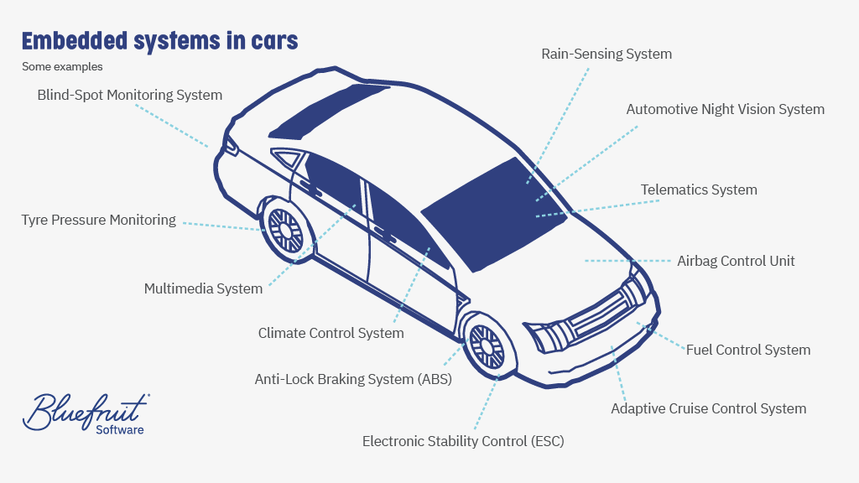

Slide 15
Controller Area Network (CAN)
Definition: Controller Area Network, a robust vehicle bus standard.
Role: Allows microcontrollers and devices to communicate without a host computer.
Applications: Used in engine management, ABS, airbags, and other real-time critical functions.
Benefits: Reduces wiring, enables faster data exchange, and improves system robustness.

Slide 16
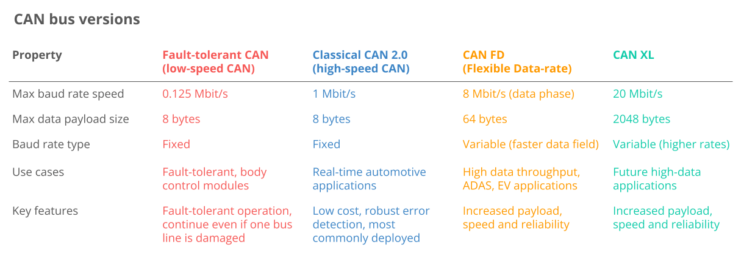
Controller Area Network (CAN)

Slide 17
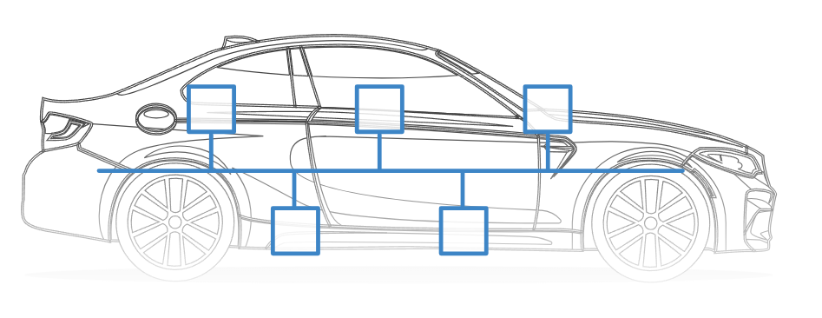
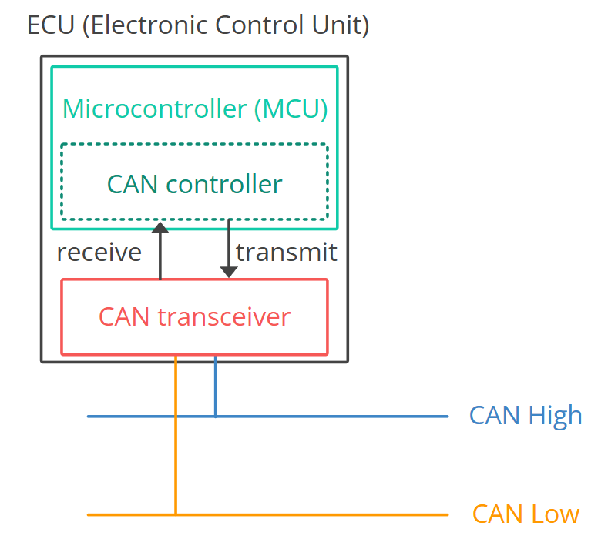
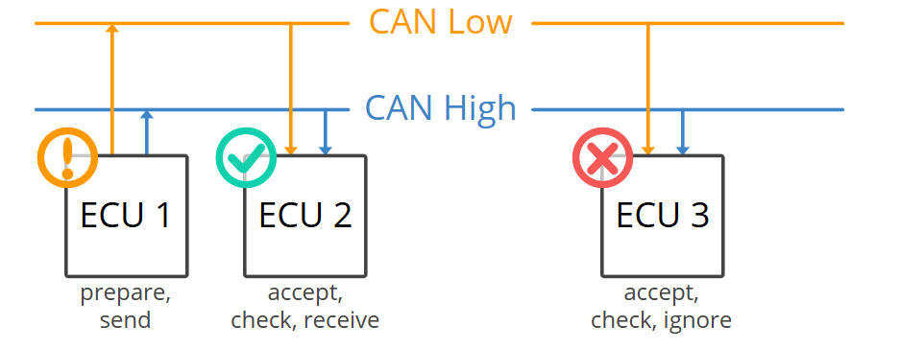
Controller Area Network (CAN)

Slide 18
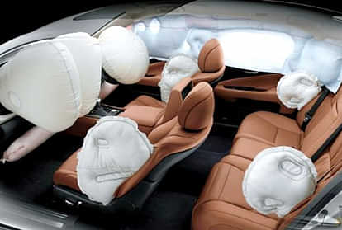
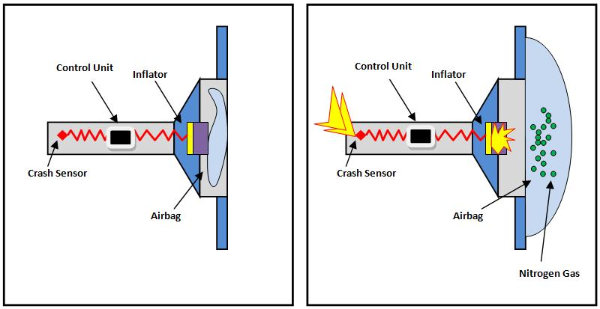
Airbag System
System Description:
Sensors detect collisions and trigger airbag deployment.
Embedded Function:
Microcontrollers analyze impact data and activate airbags within milliseconds.
Importance:
Prevents serious injuries, one of the primary safety features in modern vehicles.

Slide 19
Electronic Data Recorders (EDRs)
Definition: EDRs are often called “black boxes” for cars.
Function: Records critical data before and during crashes (e.g., speed, braking, seatbelt use).
Usage: Assists in crash analysis, insurance, and safety research.
Embedded Role: Constantly monitors and logs data without affecting vehicle performance.

Slide 20
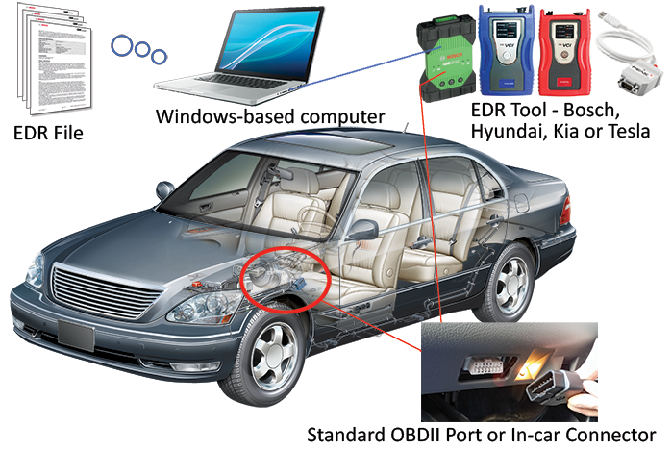

Slide 21
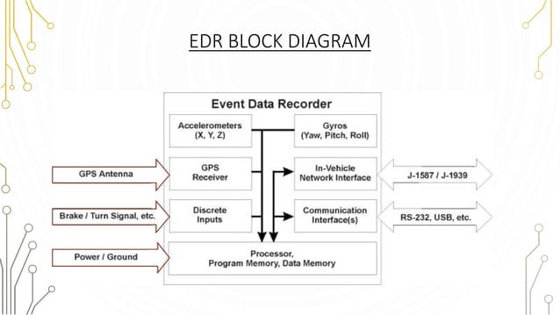

Slide 22
Anti-lock Braking System (ABS)
System Description:
Prevents wheels from locking up during braking.
Embedded Role:
Monitors wheel speed sensors, adjusts braking pressure to maintain traction.
Benefits:
Improves vehicle control during emergency braking, enhances safety on slippery roads.

Slide 23
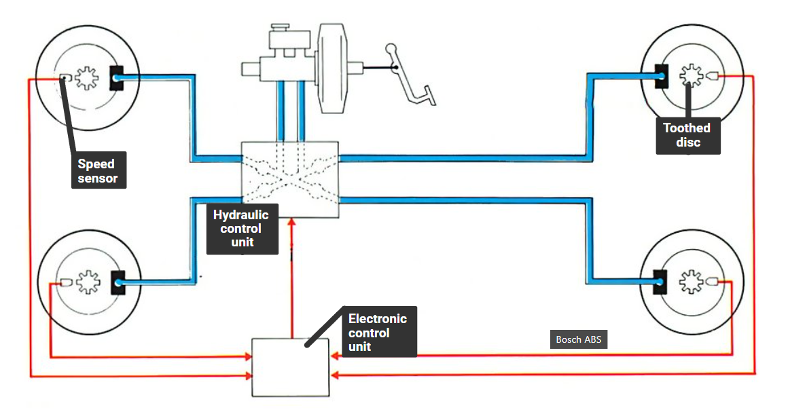

Slide 24
Principle of Working
Wheel speed sensors detect whether a wheel is showing a tendency to lock up.
In case of a lock-up tendency, the ECU reduces the braking pressure individually at the wheel concerned.
High-speed correction of braking pressure up to shortly before the lock-up threshold.
Brake-fluid return together with the closed-loop brake circuits make this safe and cost effective system.

Slide 25
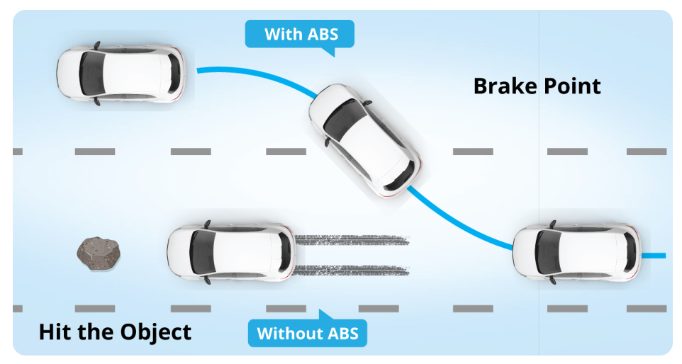

Slide 26
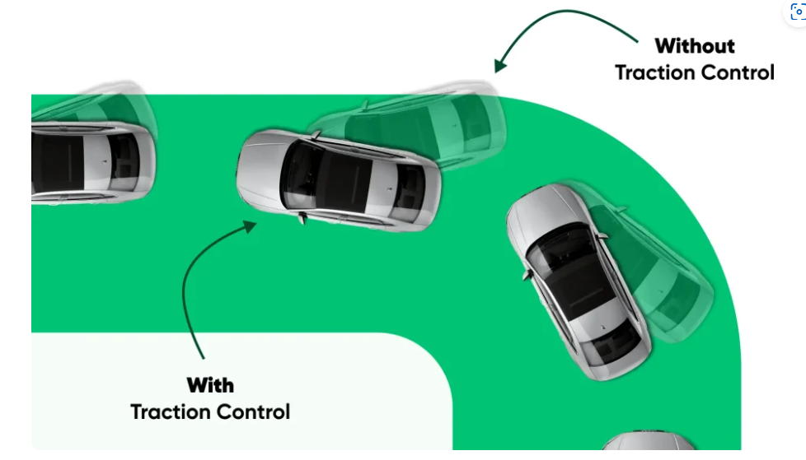
Traction Control System
Function: Prevents wheels from spinning when accelerating, especially on slippery surfaces.
Embedded Function: Monitors wheel speeds, reduces engine power or applies brakes to control wheel spin.
Safety Aspect: Improves handling and stability, especially in adverse weather conditions.

Slide 27
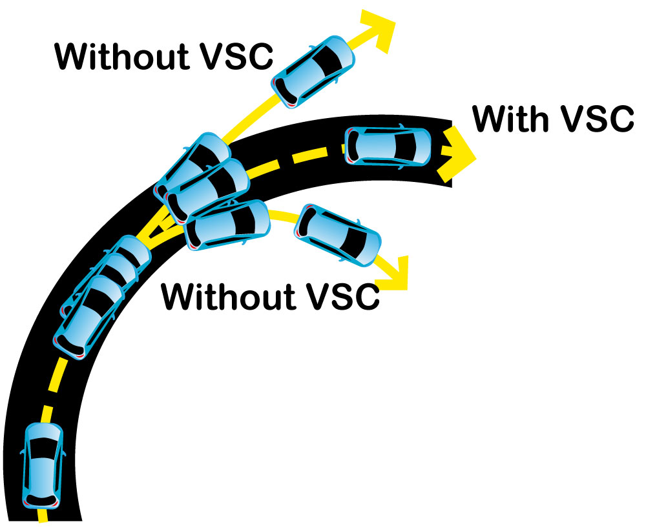
Vehicle Stability Control
System Description: Assists drivers in maintaining control during extreme maneuvers.
Embedded Function: Uses sensors to detect loss of control and applies brakes or reduces engine power.
Benefit: Reduces the risk of rollover or spinouts, improving overall vehicle safety.

Slide 28
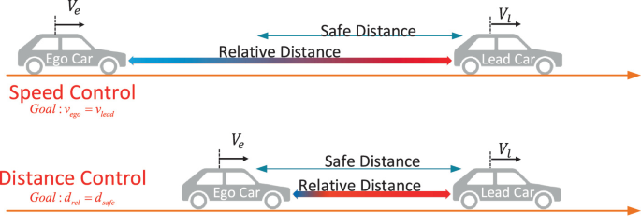
Cruise Control System
Cooperative Adaptive Cruise Control with Collision Warning
CACC : Cruise at a given speed when the road is clear (cruise control) otherwise follow the car in front, using Radar (adaptive) and/or communications (cooperative).
CW: Warn the driver when an object is being approached oto fast or it is too close.

Slide 29
Cruise Control System
System Description: Maintains a steady speed set by the driver without the need to press the accelerator.
Embedded Function: Sensors monitor speed, adjust throttle position to maintain desired speed.
Adaptive Cruise Control: Advanced system that can adjust speed based on traffic conditions.

Slide 30
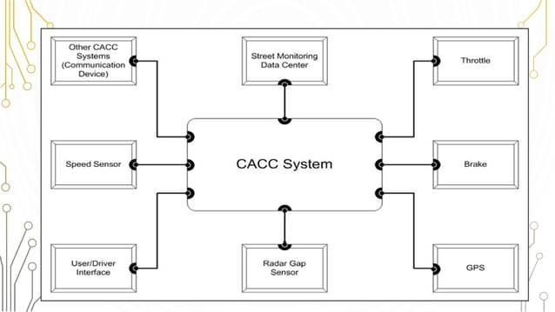

Slide 31
ADAS
Overview: Collection of systems designed to assist drivers, including lane-keeping, collision avoidance, and parking assistance.
Embedded Role: Uses multiple sensors (cameras, radar, LIDAR) and real-time data processing.
Examples: Lane Departure Warning, Automatic Emergency Braking, Blind Spot Detection.
Future Potential: Steps toward autonomous driving and enhanced driver safety.

Slide 32
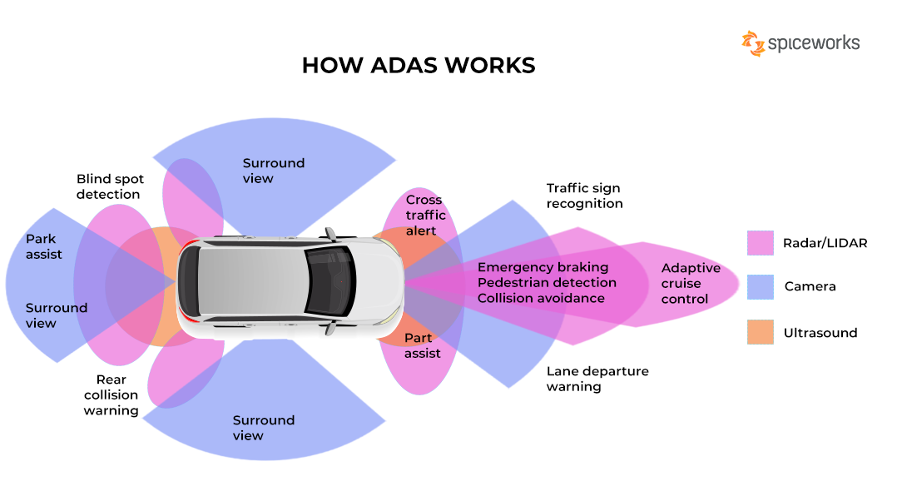

Slide 33
Drive by Wire Systems
Definition: Replaces mechanical control systems (e.g., steering, braking) with electronic controls.
Embedded Function: Sensors and actuators manage inputs like acceleration, braking, and steering.
Advantages: Reduces weight, improves response, and enables more precise control.
Applications: Used in electric vehicles, facilitates autonomous driving technologies.

Slide 34
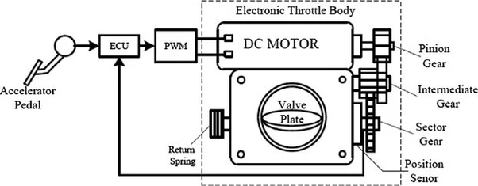
Throttle by Wire

Slide 35
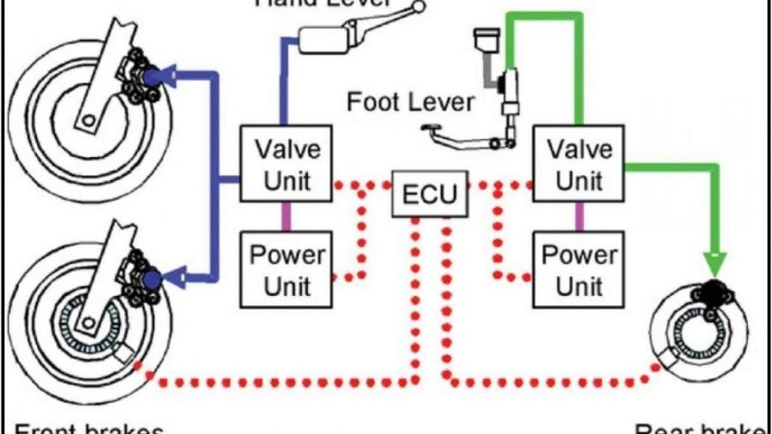
Brake by Wire

Slide 36
Consumer Electronics

Slide 37
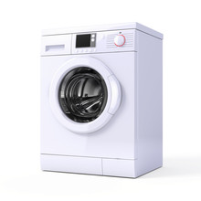
Embedded Systems in Washing Machines

Slide 38
Modes
Manual mode
Semi-automated mode
Fully automated mode

Slide 39
Fully Automated Mode
Senses the requirement of water, water temperature, detergent, load, wash cycle time and perform operations.
Instantaneously senses cloth quality
After the completion of work it should notify the user about the completion of the work.
Once the system is started it performs the task independenly without any user interference.

Slide 40
Semi Automatic Mode
Once the predefined mode is started the system perform its job.
Washing conditions are predefined
After completion it inform the user about the completion of work.

Slide 41
Manual Mode
User specify which operation, they want to do, provide related information of the control system
Example: Only wash mode, or only dry mode.
User defines the wash cycle and time, amount of water and load.
User start the machine.
Specififed operation is performed by the machine.

Slide 42
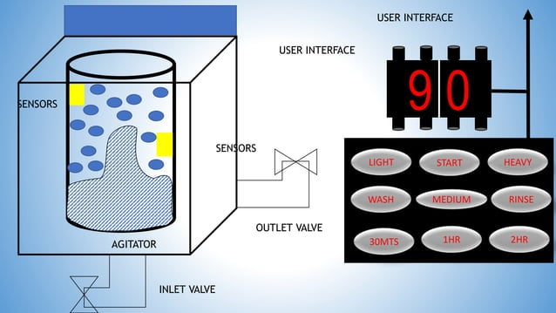

Slide 43
Components
Display Panel
Sensor
Water level sensor
Door sensor
Driving motor
Controller
Pump

Slide 44
Microcontroller and Prog. Language
Low-level programming language ,the internal functions and control the Hardware
Arduino or Raspberry PI
C/ Embedded C/C++ is a recommendation, C

Slide 45
Industrial controls

Slide 46
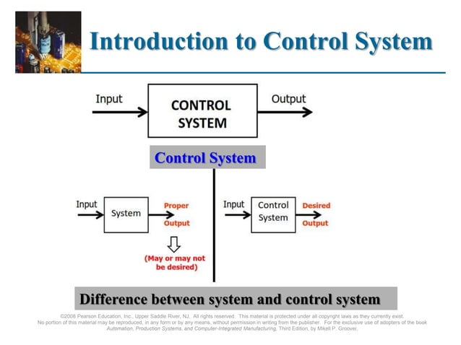

Slide 47
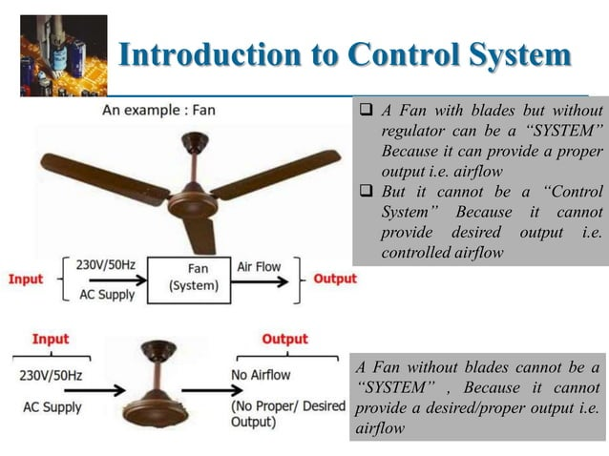

Slide 48
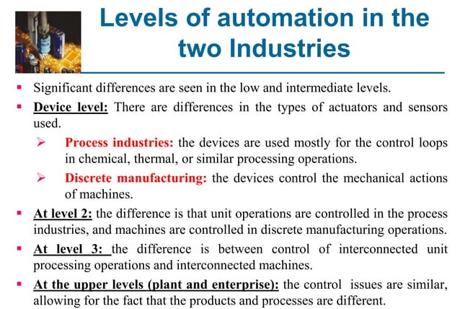

Slide 49
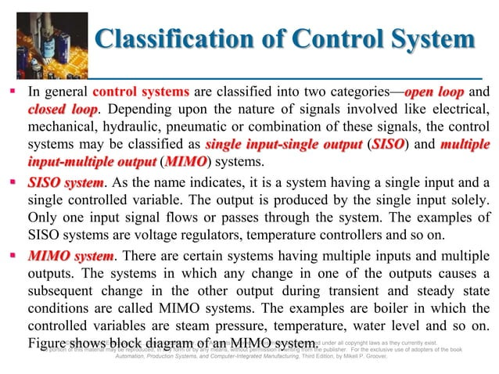

Slide 50
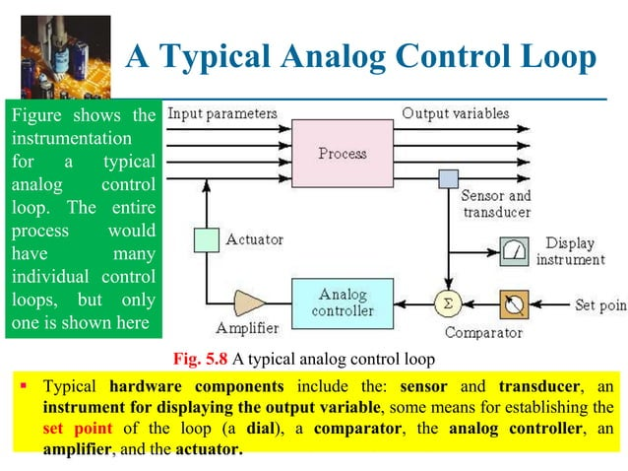

Slide 51
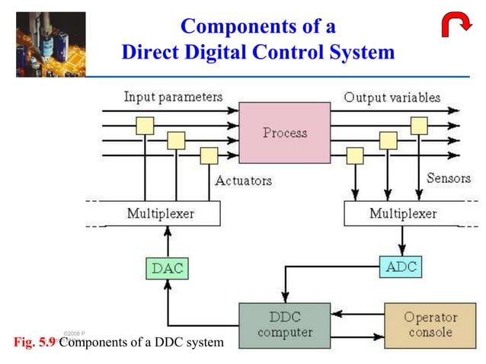

Slide 52
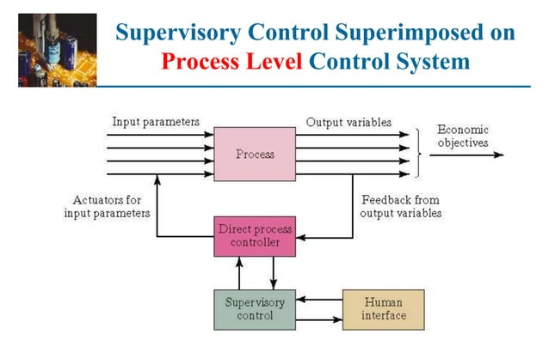

Slide 53
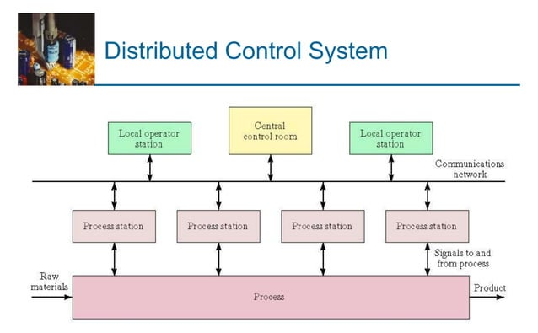

Slide 54
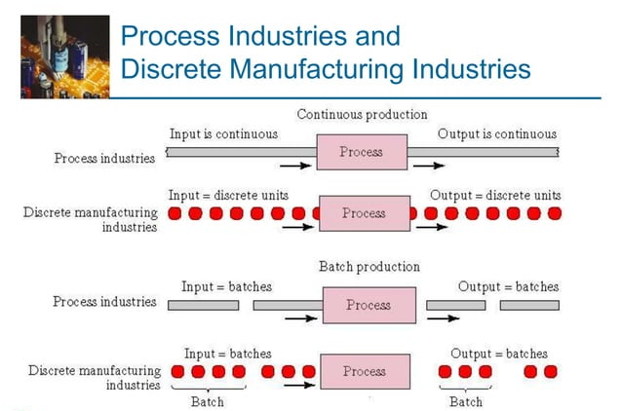

Slide 55
Medical Electronics

Slide 56
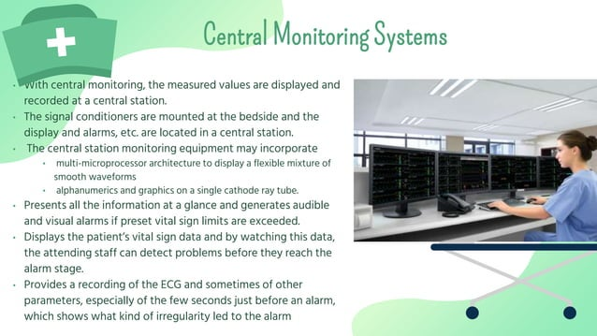

Slide 57
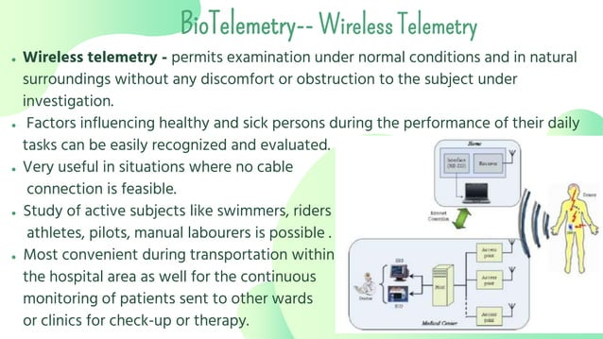

Slide 58
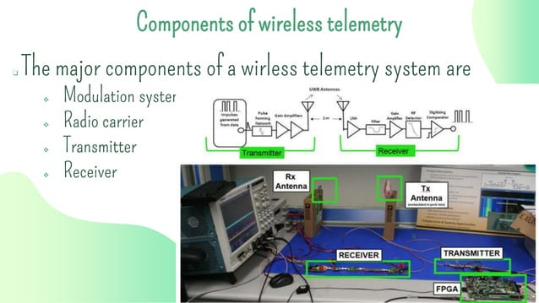

Slide 59
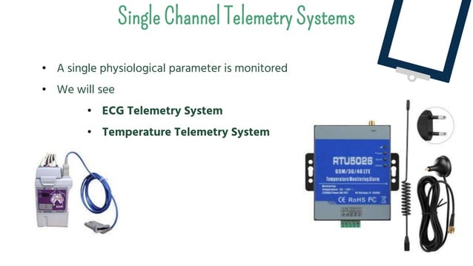

Slide 60
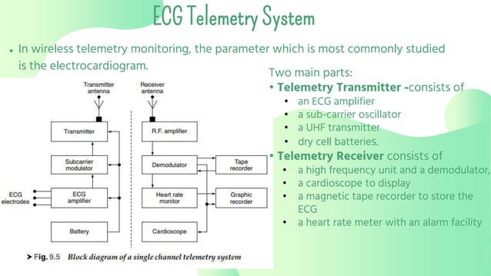

Slide 61
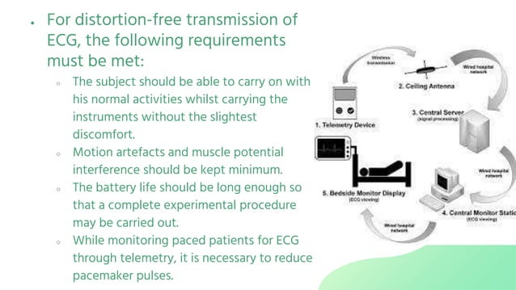

Slide 62
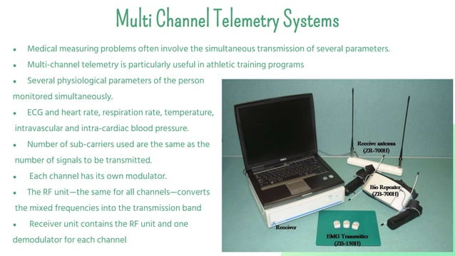

Slide 63
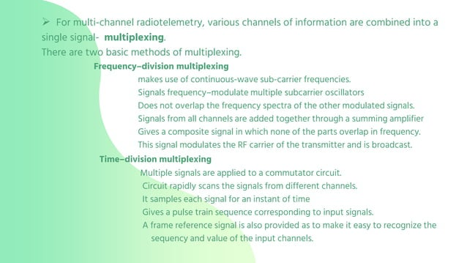

Slide 64
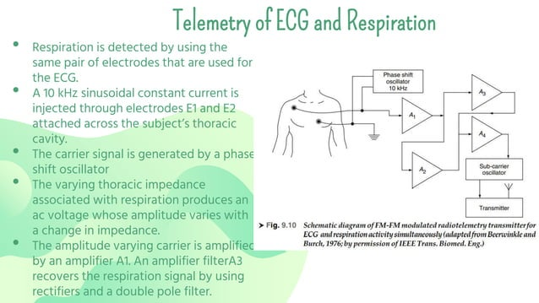

Slide 65
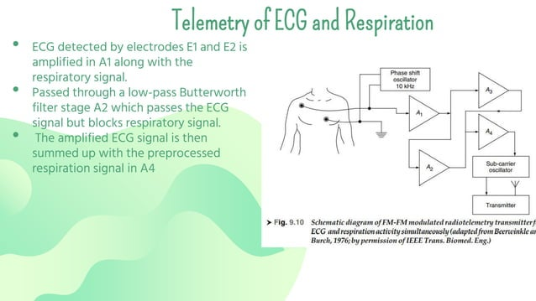

Slide 66
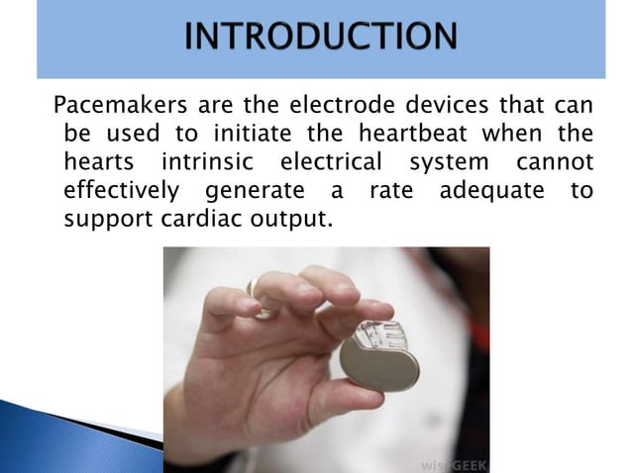

Slide 67
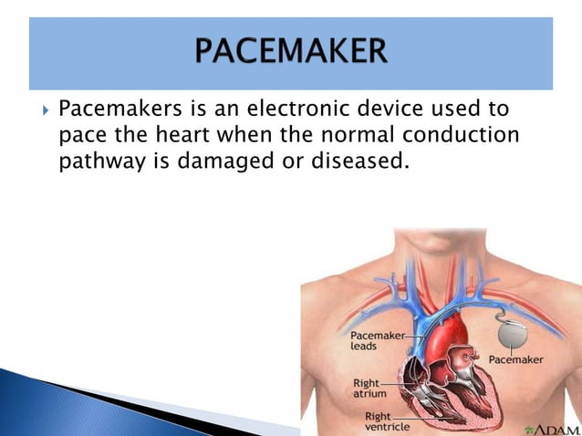

Slide 68
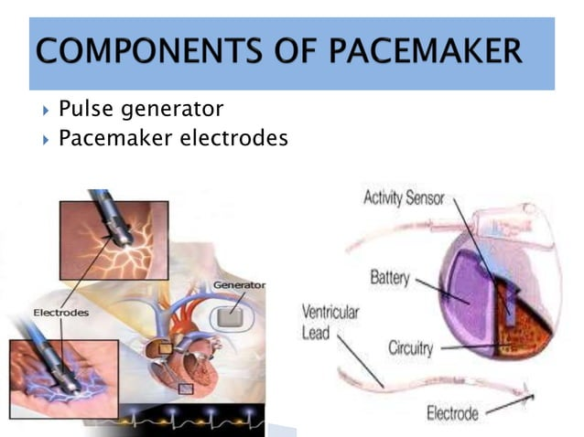

Slide 69
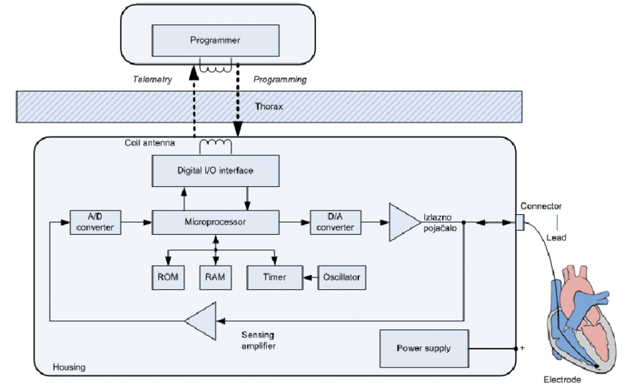
Pacemaker Block diagram

Slide 70
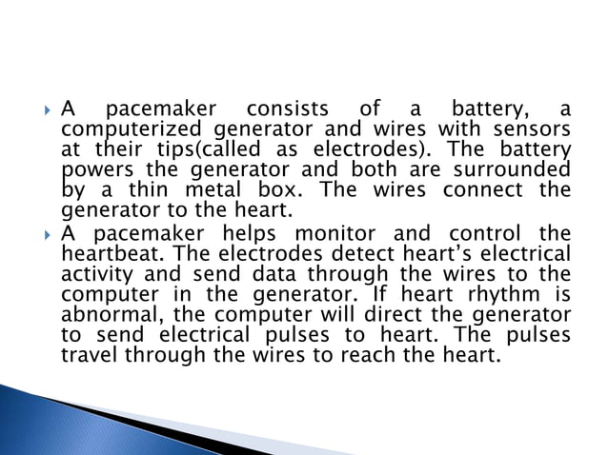

Slide 71
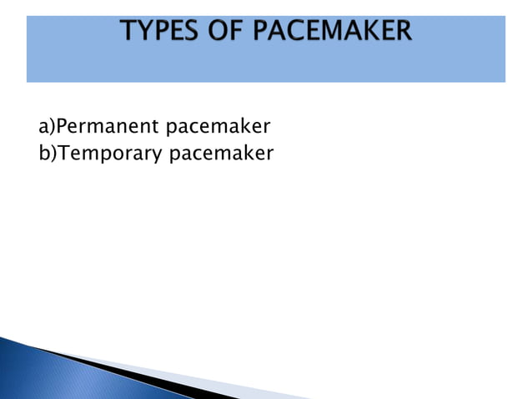

Slide 72
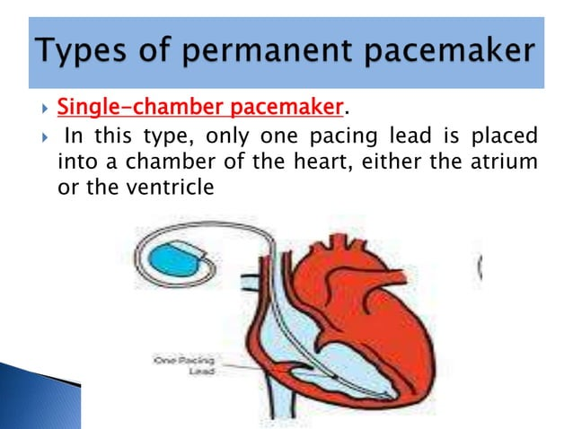

Slide 73
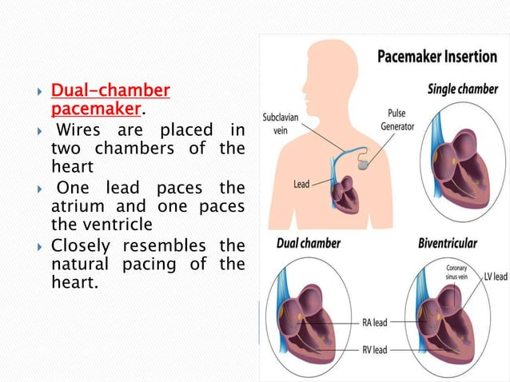

Slide 74
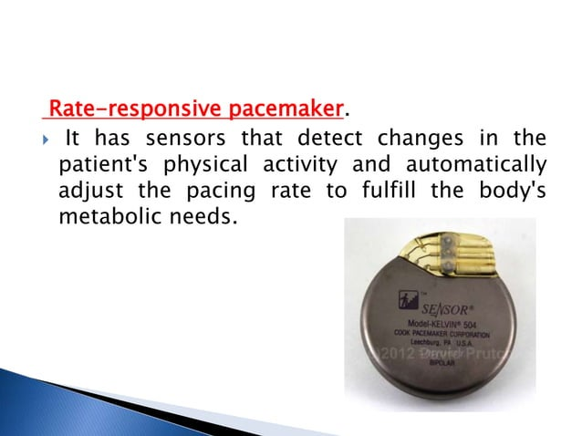

Slide 75
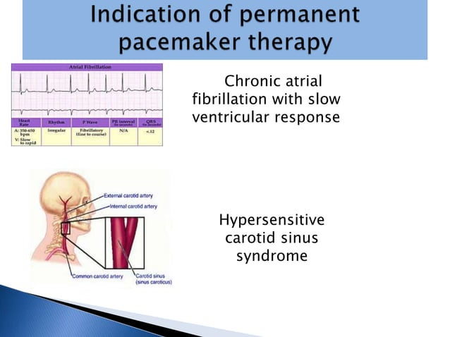

Slide 76
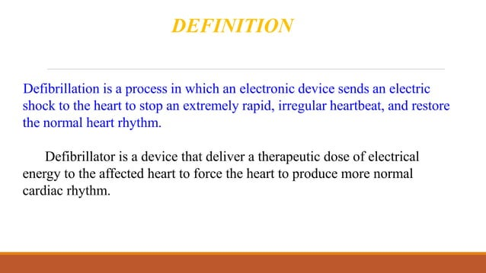

Slide 77


Slide 78


Slide 79


Slide 80


Slide 81


Slide 82


Slide 83


Slide 84

Defibrillator block diagram

Slide 85


Slide 86


Slide 87


Slide 88


Slide 89


Slide 90


Slide 91


